Slide 1
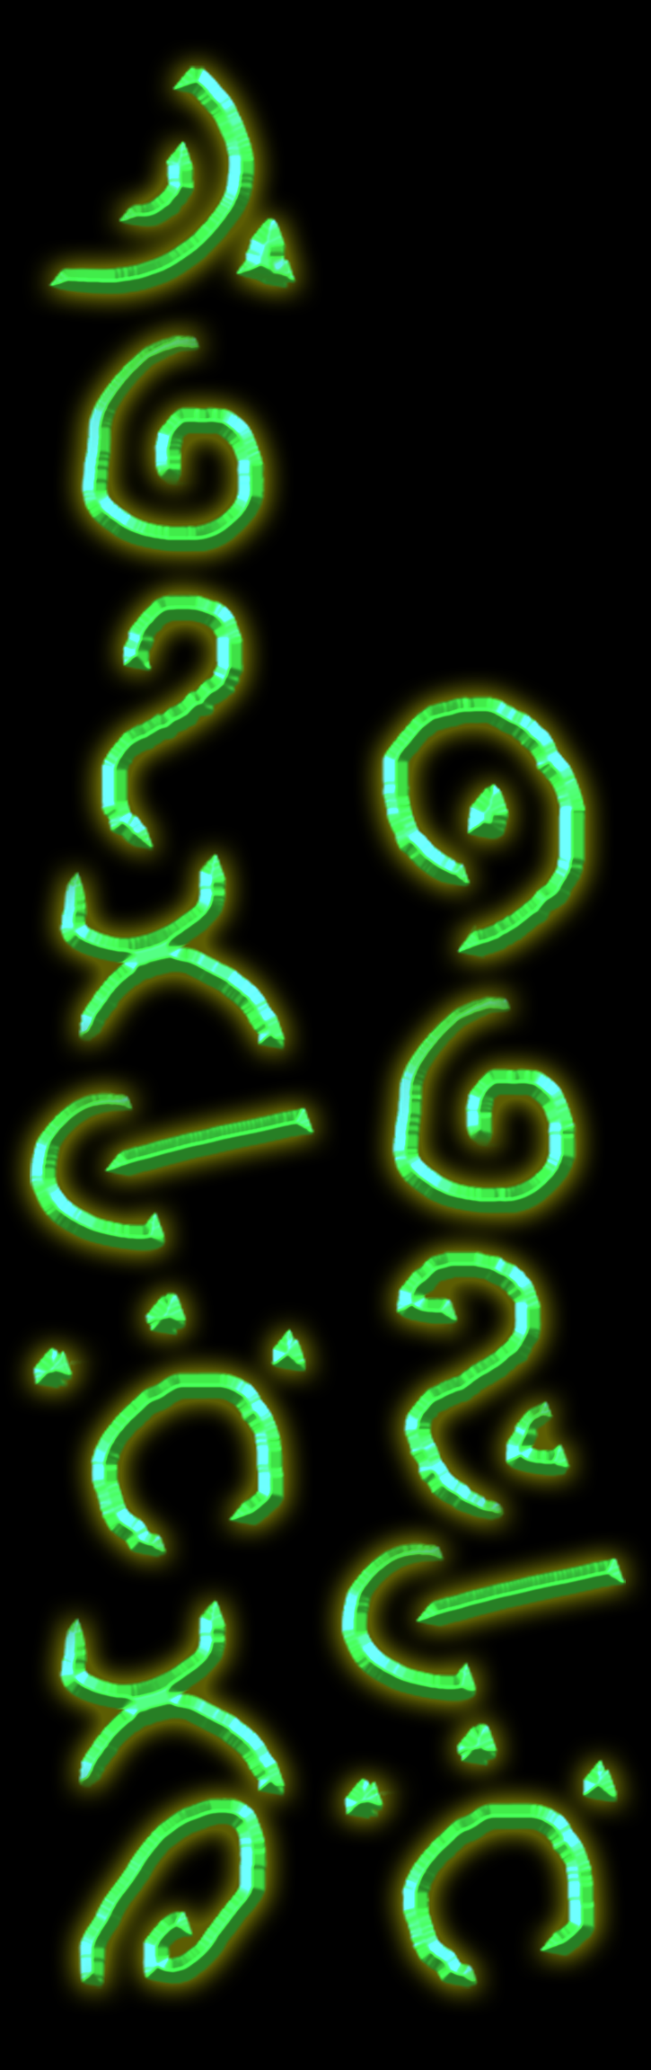
Taliesin games Tower Defence style guide
“Whoever thou art, why dost thou wander? I greet thee, a student of the arts.” Book of Taliesin, 14th Century, 1915 translation
WORKING TITLE

Slide 2
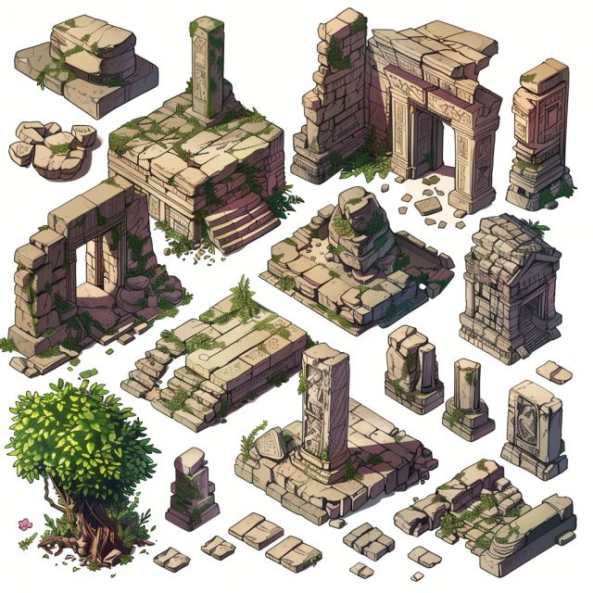
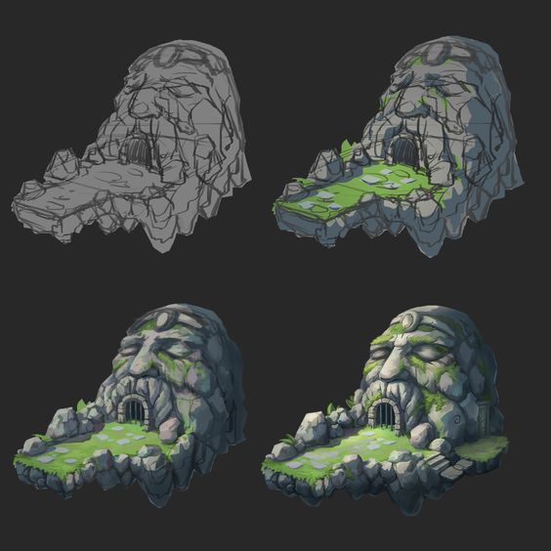
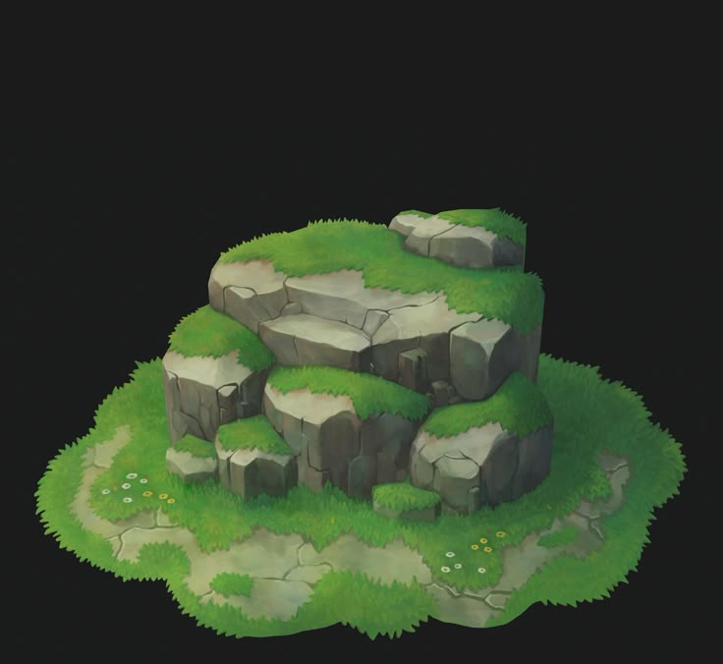
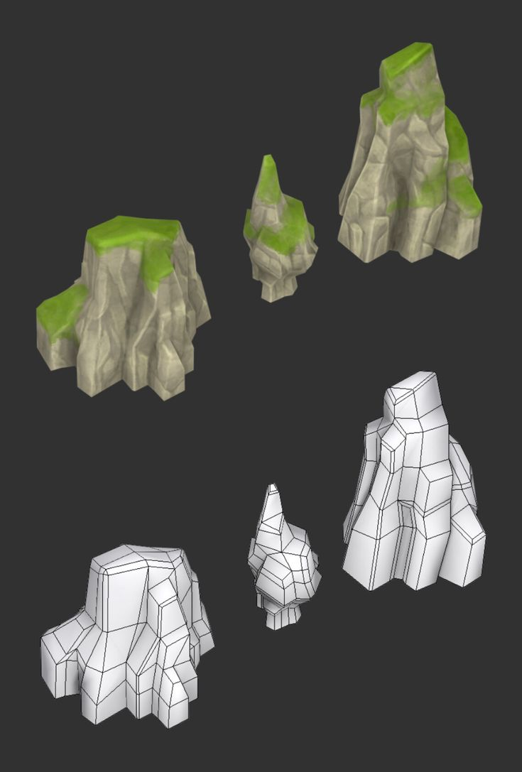
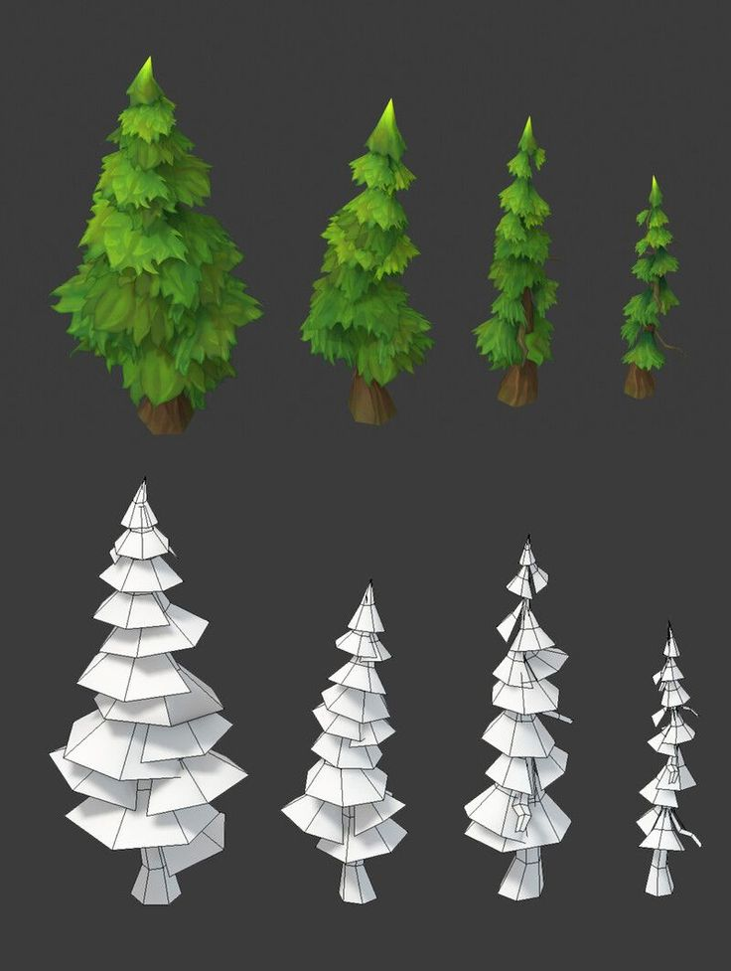
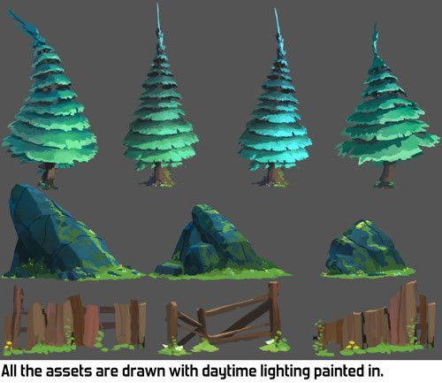
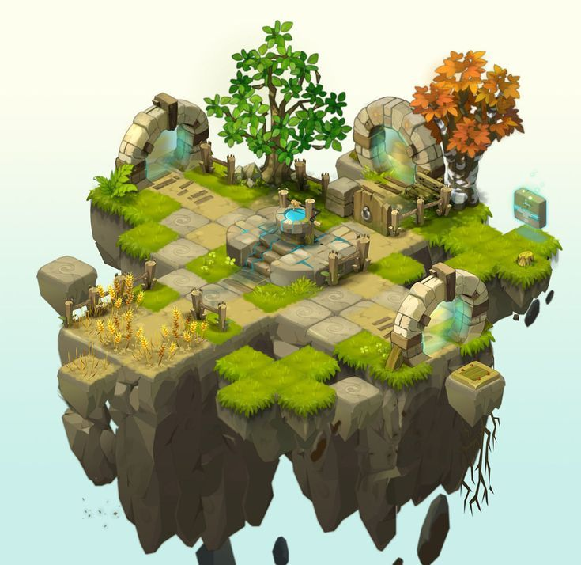
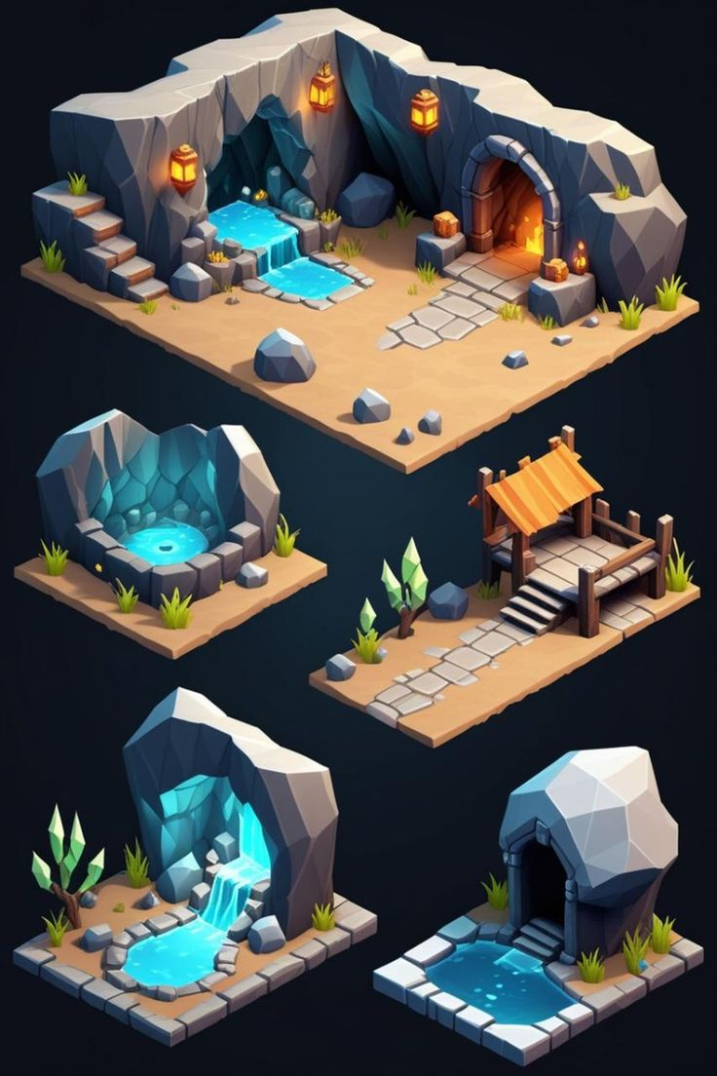
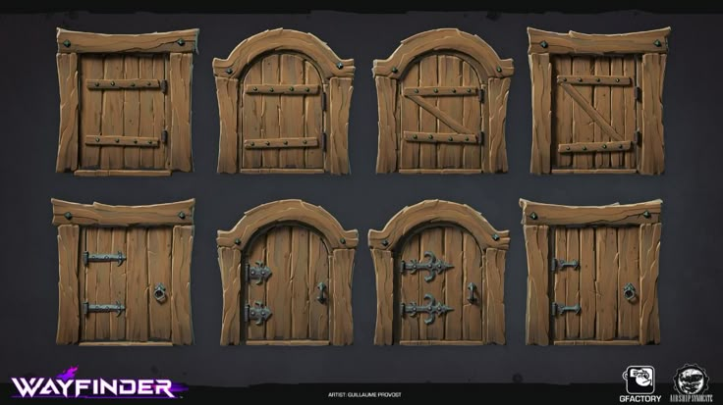
Style references

Slide 3
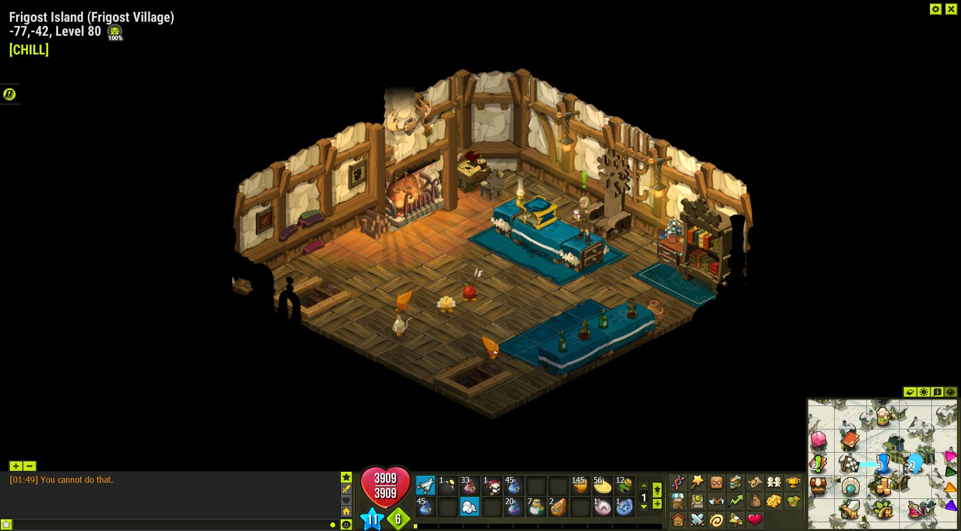
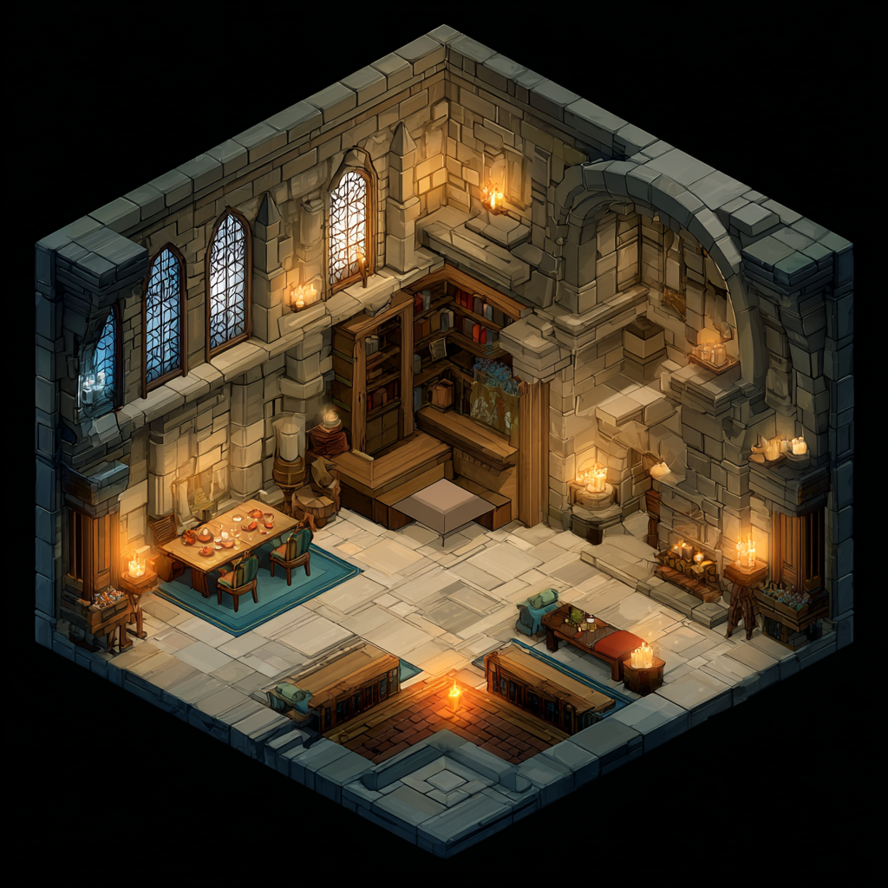
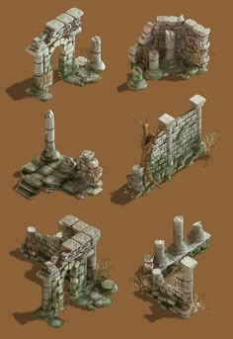
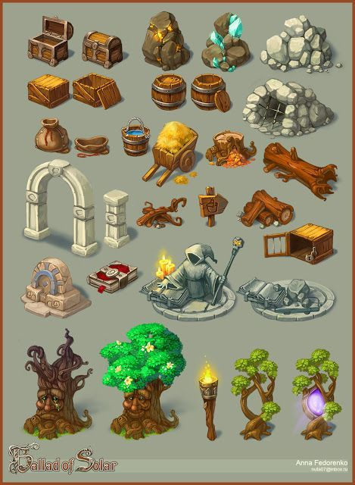
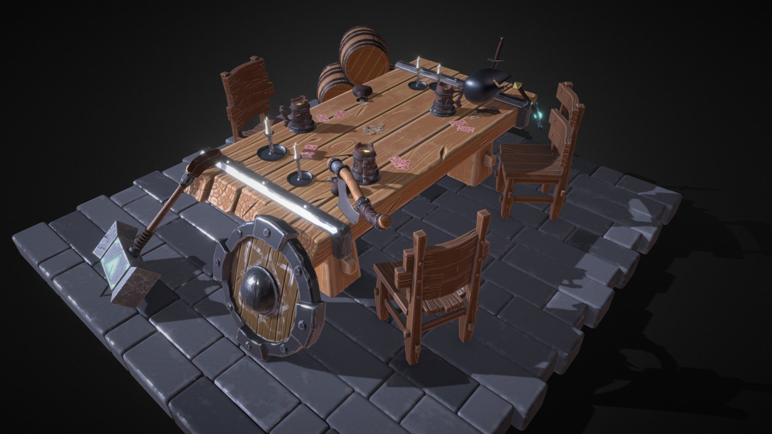
Style references

Slide 4
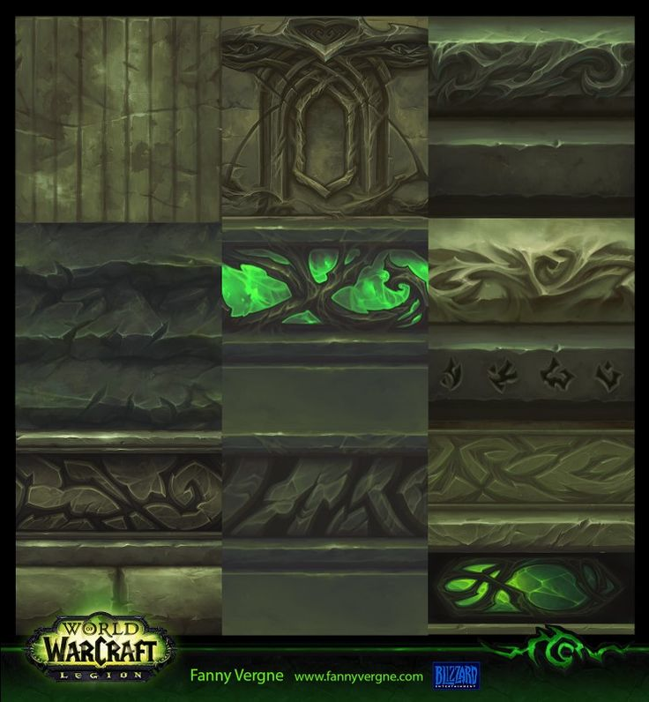
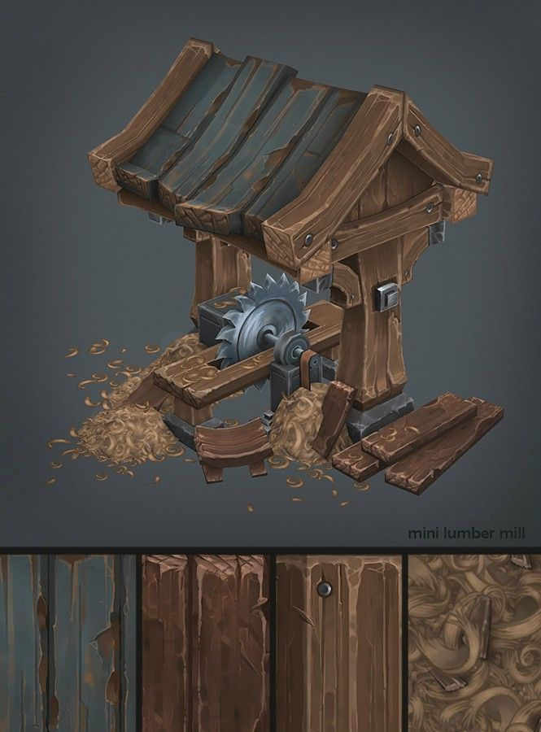
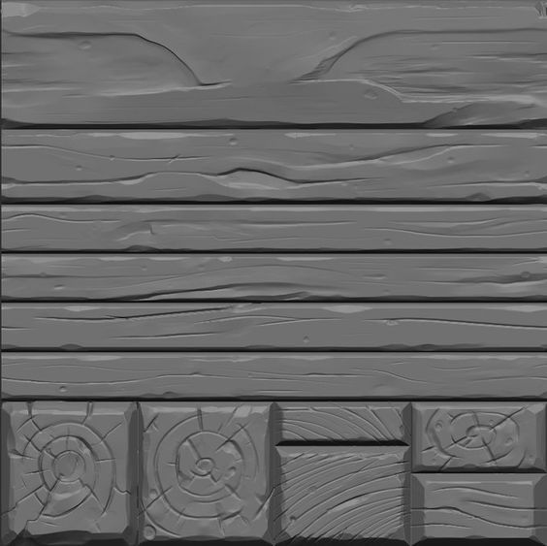
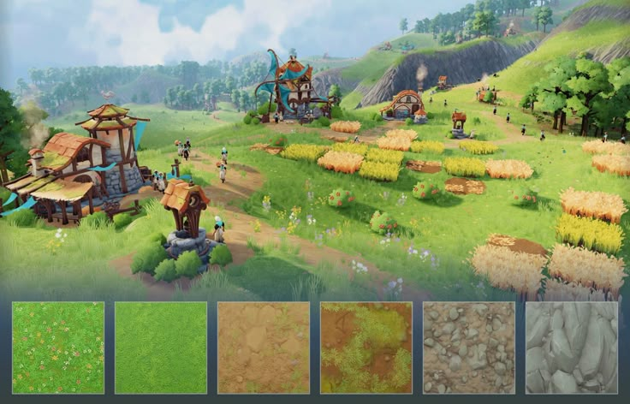
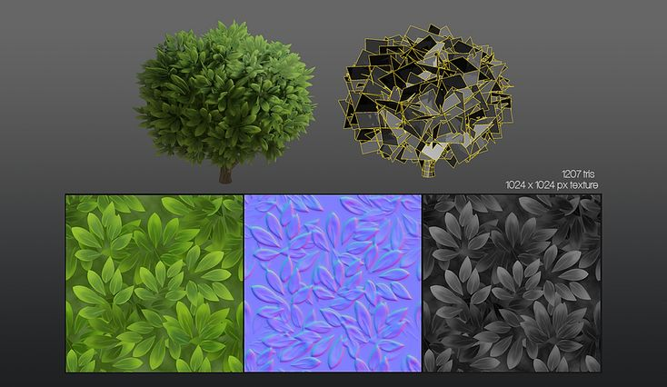
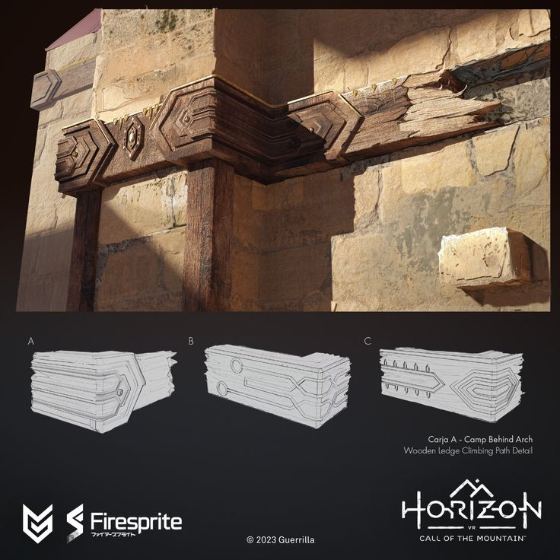
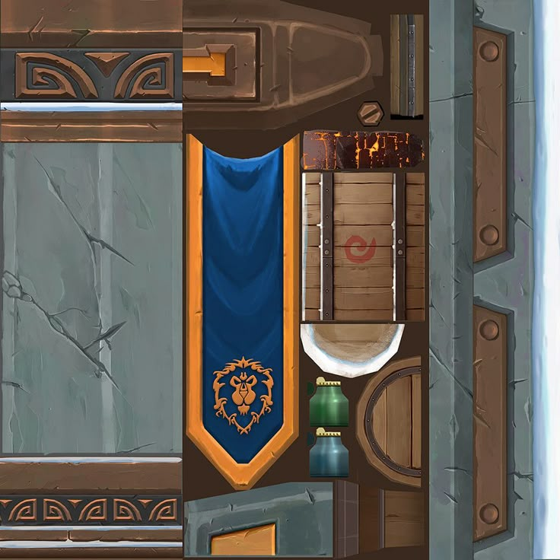
Texture references
Maintaining a visual cohesion through an agreed style

Slide 5
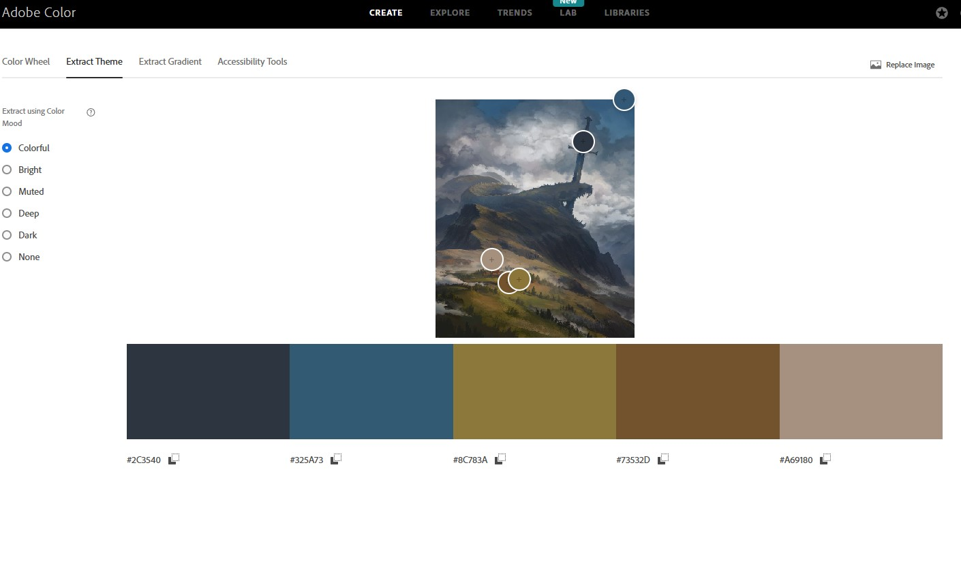
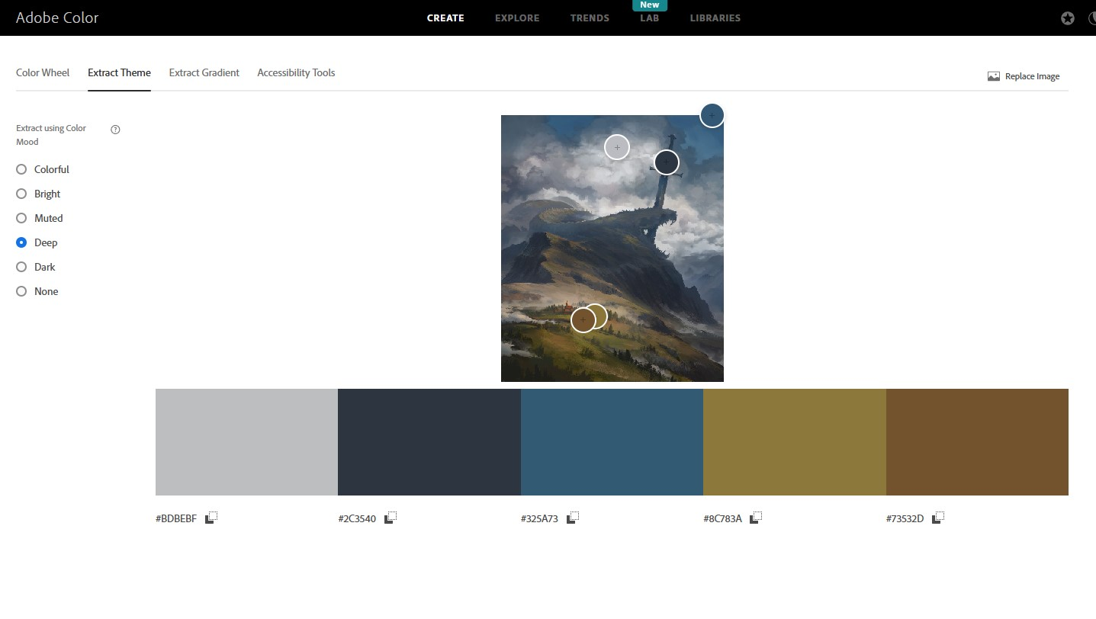
colour palette

Slide 6
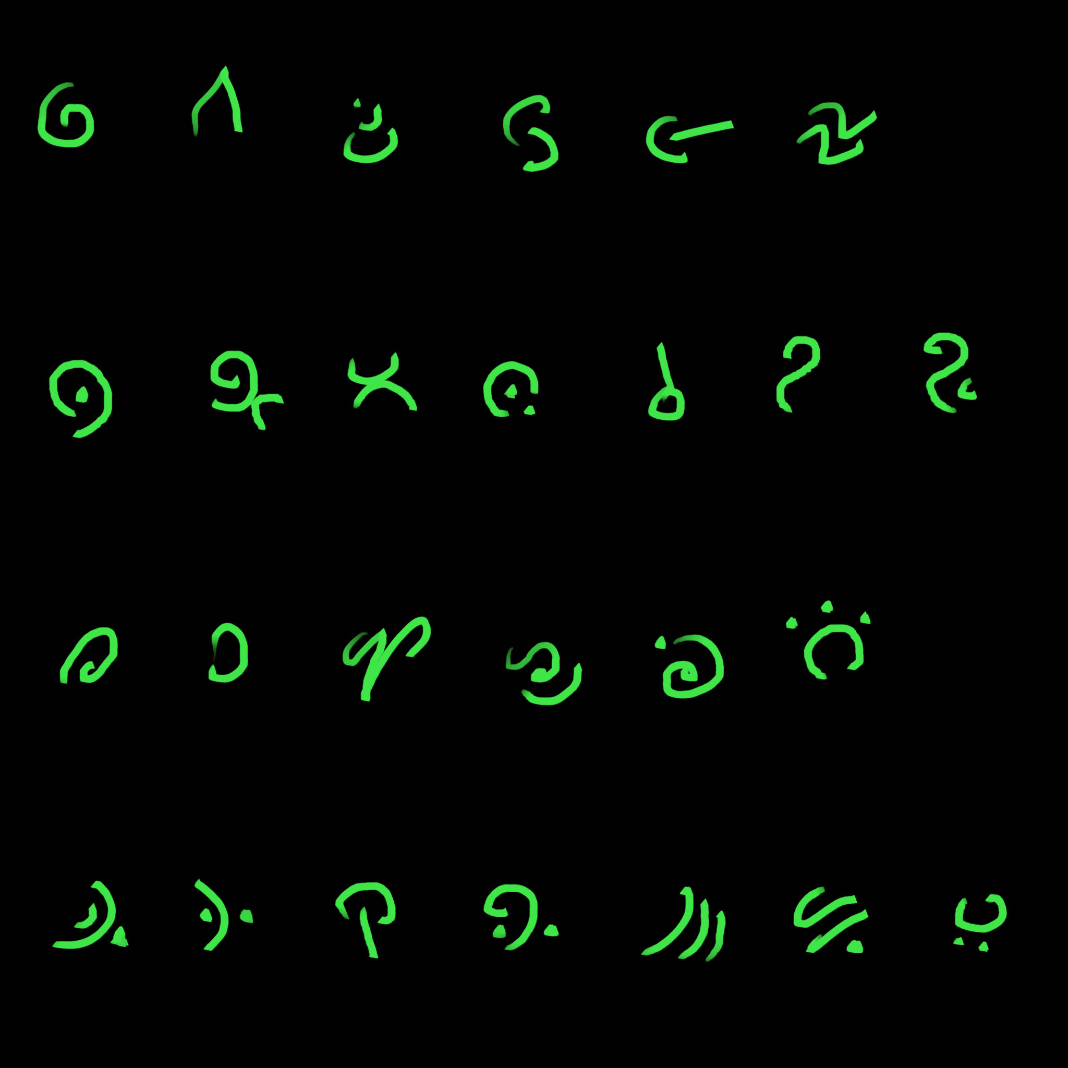
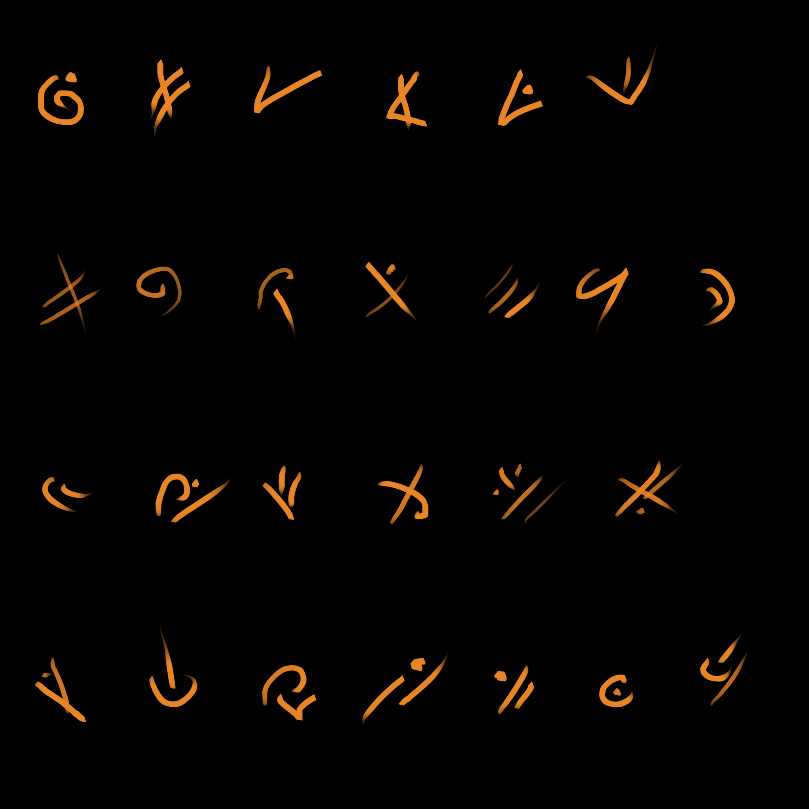
Asset list
Architecture Solid wall straight – 1m x 4m Wall High Lrg 1m x 4m Wall High Buttress 1m x 1m Ruined wall 1m x 2m Wall Corner – 2m x 2m Arch – 2m width base Tower Large, 2m x 3m Ruined Column 1m x 1m Bush Large 2m x 2m block Bush Small 1m x 1m block
Tree – 2m x 2m block, height 3m Fallen Tree 3m x 1m Entry Portal 4m x 2m

Slide 7
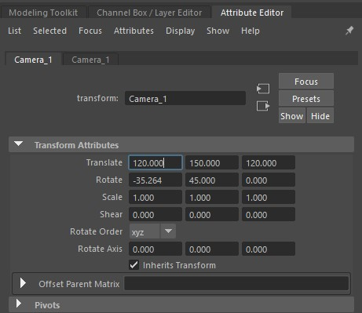
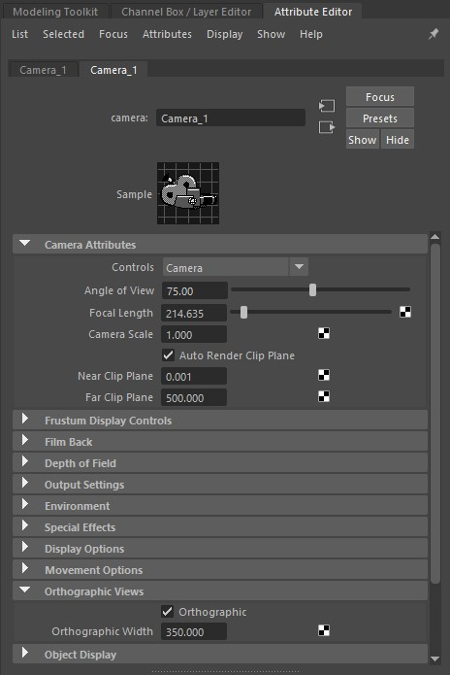
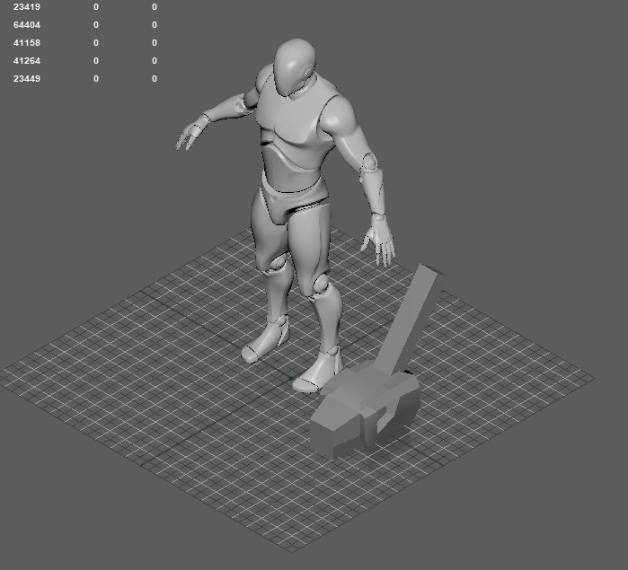
Orthographic camera setup - Maya
To aid consistent modelling from an isometric perspective, this is the setup for a camera in Maya which mimics that viewpoint.
Modelling from this angle means the assets will ‘read’ correctly when viewed.
Whilst it’s still a good idea to switch between standard perspective and locked orthographic mode whilst modelling, all designs should keep in mind the final view angle.
This saves a lot of later tweaks and means you are not modelling detail that will never be seen.
Maya Camera Settings
Notes
Create – Cameras – Camera Select in Outliner Go to Attribute Editor
Camera1 tab – Transform Attributes Translate: 120, 150,120 Rotate: -35.264,45,0 (Note -30 is dimetric, -35.264 is isometric ‘squashed’)
CameraShape1 tab – Camera Attributes Angle of view 75 Near Clip Plane – 0 (defaults to 0.001) Far Clip Plane – (minimum) 500 Orthographic View Tick ‘Orthographic’ box. Width 350.00
The orthographic camera can zoom in/out but should not rotate.
This setup accommodates a standard human figure on a 100x100cm (1mx1m) grid. If you increase the size of the working area, clipping issues will occur. To fix this, you need to adjust your translations x & z should be the same number to keep the view centred laterally. You may need to increase Far Clip Plane distance.
For example: Grid size of 1000 x 1000cm (10mx10m) x, y, z – 1200, 1200, 1200, Far Clip Plane 10,000
To see how the grid and model are actually sitting in the viewbox, switch to any other camera view whilst keeping the Orthographic camera selected in the Outliner.

